Slide 1
WATER POLLUTION AND ITS MANAGEMENT UNIT II 18CEO405T
Dr. S. Karuppasamy
Department of Civil Engineering
SRMIST

Slide 2
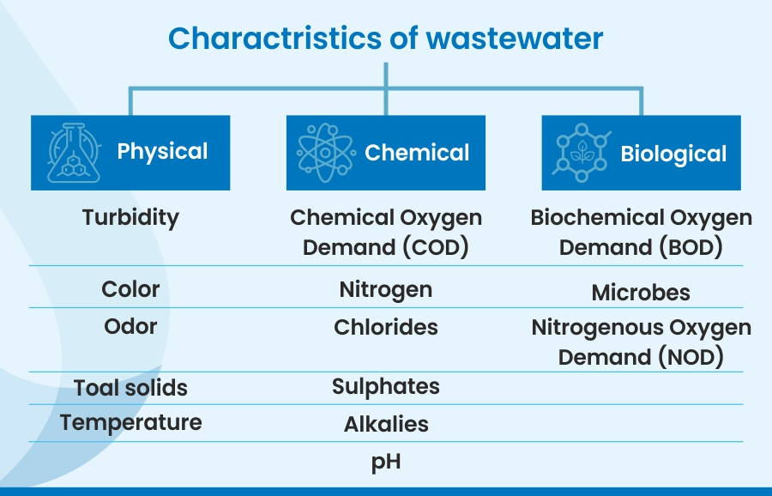

Slide 3
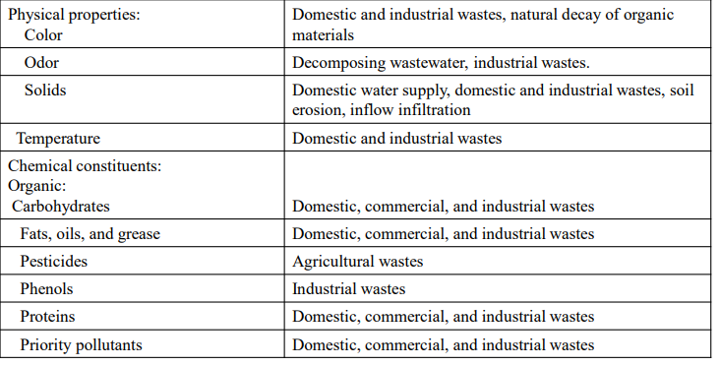
PHYSICAL, CHEMICAL AND BIOLOGICAL PROPERTIES OF WASTE WATER

Slide 4
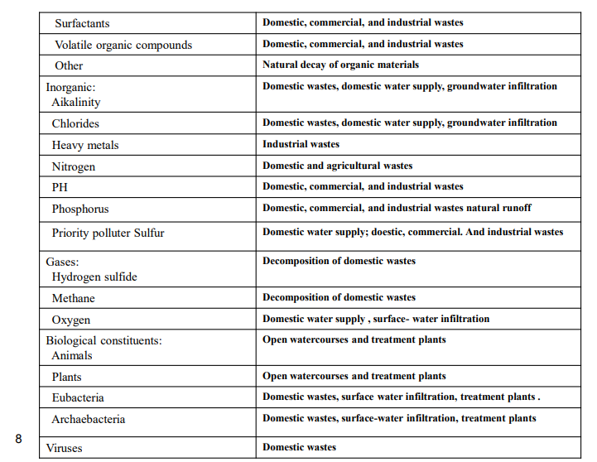
PHYSICAL, CHEMICAL AND BIOLOGICAL PROPERTIES OF WASTE WATER

Slide 5
S1-SLO 2- Physical characteristics
Impurities in water may be classified as follows
(a) Physical impurities
(b) Chemical impurities
(c) Bacteriological impurities
Physical Impurities:
They are due to the presence of inorganic substances like clay, pebbles, sand silt, algae, fungi, bacteria etc. in water as finely divided compounds.
Lighter substances float, heavier substances settle and of equal specific gravity mix with water.
They impart colour, odour and taste ,Turbidity, Temperature , Specific Conductivity to water. They are not serious and can be easily detected and removed.
They may be in suspended, dissolved and colloidal forms.

Slide 6
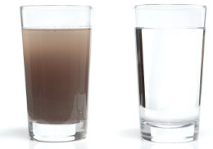
S1-SLO 2- Physical characteristics
COLOUR:
Colored discharge from some industries impart colour to water
Color is undesirable in water, it may stain clothes & injurious to human health also
Dissolved organic matter from decaying vegetation or some inorganic materials may impart colour to the water. Excessive growth of Algae.
It can be measured by comparing the colour of water sample with other standard glass tubes containing solutions(PLATINUM COBALT) of different standard colour intensities.(NESLER’S TUBE)
The IS value for treated water is 20 cobalt units, Preferably <10 cu.

Slide 7
S1-SLO 2- Physical characteristics
Colour, Hazen Units
WHO | Desirable : 5 Hazen units. , Permissible : 15 Hazen units.(Pt/Co scale)
Risks or effects | Harmless; Visible tint - acceptance decreases
Sources | Coloured organic substances (humus), Iron (red) , Copper (blue–green), Manganese (black), highly coloured industrial wastes (pulp and paper and textile wastes)
Treatment | Centrifugation and Filtration, Distillation, Reverse osmosis

Slide 8
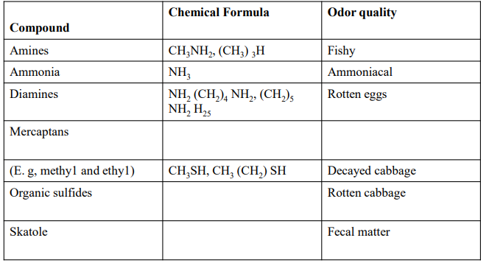
S1-SLO 2- Physical characteristics
Physical characteristics – Odor
Odor is produced by gas production due to the decomposition of organic matter or by substances added to the wastewater.
Detection of odor: Odor is measured by special instruments such as the Portable H2S meter which is used for measuring the concentration of hydrogen sulfide.

Slide 9
TASTE AND ODOUR
S1-SLO 2- Physical characteristics
Dissolved organic materials CH₄, H₂S,CO₂ etc.,
The intensities of taste and odour depend upon the sensitivity of the observer.
Their presence in water may be due to the presence of dead or live micro-organisms, dissolved gases or mineral substances.
Tastes may be sweet, bitter, salty, brackish, irritating hot and cold. Odour may be fishy, earthy, grassy, mouldy etc. (Odour intensity)
Odour is identified by inhaling through two tubes of an osmoscope. Threshold odour.
One tube is kept in a flask containing distilled water and the other is kept in a flask containing water sample.
It is also measured by dilution with odour free water in different ratios. Permissible limit 1 never exceed 3.
The dilution ratio giving the first detectable odour threshold number.

Slide 10
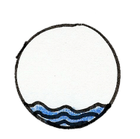
S1-SLO 2- Physical characteristics
Odour
WHO | Unobjectionable
Risks or effects | Natural odours – earthy, musty or sour, fishy, grassy Due to growth of aquatic plants (surface waters) and animals (Underground waters). Algae – secrete oils during metabolic activity or when dead cells disintegrate – increase chlorine demand Industrially derived – Petroleum or creosote or medicinal odour Biological growth – Nonspecific fishy, grassy and musty
Sources | Pollution of the water source - organic substances, biological or industrial origin, dumping of raw sewage into the aquatic environment Iron and sulfur bacteria in distribution system
Treatment | Activated carbon, Air stripping, oxidation, Filtration

Slide 11
S1-SLO 2- Physical characteristics
PHYSICAL CHARACETERISTICS – TEMPERATURE:
Temperature of wastewater is commonly higher than that of water supply. Depending on the geographic location the mean annual temperature varies in the range of 10 to 21oC with an average of 16 º C.
Importance of temperature:- Affects chemical reactions during the wastewater treatment process.
Affects aquatic life (Fish, …………).
Oxygen solubility is less in worm water than cold water.
Optimum temperature for bacterial activity is in the range of 25°C to 35
Aerobic digestion and nitrification stop when the temperature rises to 50o C. When the temperature drops to about 15°c, methane producing bacteria become in active. Nitrifying bacteria stop activity at about 5°c.

Slide 12
S1-SLO 2- Physical characteristics
Temperature
The increase in temperature decreases palatability, because at elevated temperatures carbon dioxide and some other volatile gases are expelled.
The ideal temperature of water for drinking purposes is 5 to 12 °C ,10 °C is highly appreciable. above 25 °C, water is not recommended for drinking.

Slide 13
S1-SLO 2- Physical characteristics
Specific conductivity or electrical conductivity
Pure water is a poor conductor of Electricity, But it shows significant conductivity when ions of dissolved salts are present in it.
Approximately No of ions = Approx Total dissolved solids in water.
Main source Calcium(Ca++ ), Magnesium(Mg ++ ) , potassium(K+ ), Bicarbonates(HCO3- )
The specific conductivity is measured by portable ionic tester called Conductivity sensor.

Slide 14
S1-SLO 2- Physical characteristics
Specific conductivity or electrical conductivity
The unit is mhos/cm (mhoms= 1 ampere/1 volt). This unit renamed by ISO(International standard organisation) as Siemen ( 1 mohs=1 Siemens).Since mhos is a very large unit,the micromhos i.e. microsiemen (μS/cm) is typically used.
It increased based on temperature, its measurement is normally standardise @ 25 °C.
CONDUCTIVITY FACTOR(μS/cm to ppm) it varies 0.54-0.96.A value of 0.67 is commonly used as an approximately.
TDS (in ppm or mg/l)= Conuctivity (μS/cm ) * 0.67

Slide 15
S1-SLO 2- Physical characteristics
Turbidity :
Turbidity depends on finess and concentration of particles present in water. This is expressed by the amount of suspended matter in parts per million ppm or mg/L( 1 mg of finely divided silica in 1 L of disstilled water) in water as ascertained by observations.
Turbidity is determined in terms of the optical property of the sample. The higher the turbidity, the greater the absorption of light rays from a source of light on the opposite side of the sample and less that is transmitted in straight lines through the sample.
Turbidity is determined by an instrument called turbidimeter( earlierly Turbidity rod) . Common turbidimeters in use are,

Slide 16
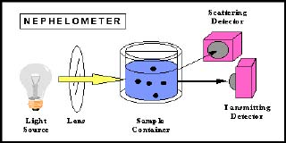
BAYLIS TURBIDIMETER
This instrument consists of a galvanized iron box enclosing two glass tubes kept at one end and a 250 watts bulb with reflection at the other end.
The glass tubes are supported by a white opal glass plate at their feet.
They are surrounded all around by the blue cobalt plates at their feet. They are fitted firmly in position by a small platform with beveled holes.

Slide 17
BAYLIS TURBIDIMETER
One tube is filled with water sample and the other with a standard solution of known turbidity.
The bulb is lighted and the blue light cast in the tubes is observed from the top and is compared.
If it matches, then the turbidity of the standard solution corresponds to the turbidity of the sample.
Otherwise the standard solution of different turbidity are compared till the colour matches.
This instrument is preferable for turbidity less than 5 ppm.

Slide 18
HELLIGE TURBIDIMETER
This instrument consists of a box like container with a graduated knob on the side and an eyepiece at the top.
The tube containing the water sample is placed in the box. A small circular, central spot, lighter or darker placed below the sample is observed through the eyepiece.
It is balanced with the surrounding field by turning the calibrated knob till the spot exactly merges with the surrounding field.
At this instant, the turbidity is read directly from the scale on the dial.
Turbidity from 0 to 150 ppm can be determined by this instrument without using any standard solution.

Slide 19
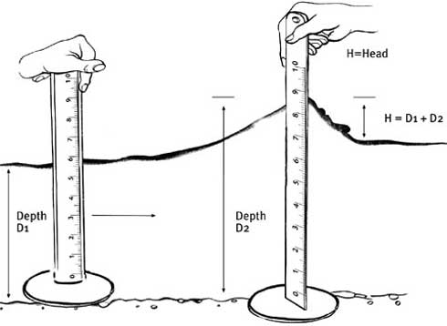
HELLIGE TURBIDIMETER
Working principle of Hellige and Baylis turbidimeters is based upon the Tyndall effect which consists in comparing direct beam of light unaffected by turbidity with transverse beam that scatters light depending upon the water turbidity.

Slide 20
S2-SLO 1- Chemical characteristics
Chemical Impurities:
They may be either organic or inorganic.
They may be present in either suspended or dissolved form.
The suspended organic chemical impurities are due to the presence of vegetables or animals in water.
The vegetables are in the form of algae, fungi, decayed leaves, etc.
They impart acidity, colour and taste to water.
The dissolved organic chemical impurities are due to the melting of vegetables and animals in water.

Slide 21
CHEMICAL CHARACTERISTICS
The health concerns associated with chemical constituents of drinking-water arise mainly from the ability of chemical constituents to cause adverse health effects after extended exposure time.
There are few chemical constituents of water that can lead to health problems resulting from even a single exposure.
pH
Electrical conductivity
Salinity
Alkalinity
Hardness
Heavy metals
Dissolved oxygen

Slide 22
CHEMICAL CHARACTERISTICS
pH:
pH is a measure of how acidic or basic (alkaline) the water is.
It is defined as the negative log of the hydrogen ion concentration.
The pH scale is logarithmic and ranges from 0 (very acidic) to 14 (very alkaline).
For each whole number increase (i.e. 1 to 2) the hydrogen ion concentration decreases tenfold and the water becomes less acidic. T
he range of natural pH in fresh waters extends from around 4.5, for acid, peaty upland waters, to over 10.0 in waters where there is intense photosynthetic activity by algae.
Changes in pH may alter the concentrations of other substances in water to a more toxic form. Ammonia toxicity, chlorine disinfection efficiency, and metal solubility are all subjective to changes in pH value.

Slide 23
CHEMICAL CHARACTERISTICS
ELECTRICAL CONDUCTIVITY
The conductivity of water is an expression of its ability to conduct an electric current as a result of breakdown of dissolved solids into positively and negatively charged ions.
The major positively charged ions are sodium (Na+ ), calcium (Ca+2), potassium (K+ ) and magnesium (Mg+2). The major negatively charged ions in water include chloride (Cl- ), sulfate (SO4 -2 ), carbonate (CO3 -2 ), and bicarbonate (HCO3 - ). Nitrates (NO3 -2 ) and phosphates (PO4 -3 ) are minor contributors to conductivity, although they are very important biologically.
Conductivity will vary with water source: ground water, water drained from agricultural fields, municipal waste water, rainfall.
Therefore, conductivity can indicate groundwater seepage or a sewage leak.

Slide 24
CHEMICAL CHARACTERISTICS
Salinity:
Salinity is a measure of the amount of salts in the water. Because dissolved ions increase salinity as well as conductivity, the two measures are related.
The salts in sea water are primarily sodium chloride (NaCl).
However, other saline waters owe their high salinity to a combination of dissolved ions including sodium, chloride, carbonate and sulfate.
Salts and other substances affect the quality of water used for irrigation or drinking.
They also have a critical influence on aquatic biota, and every kind of organism has a typical salinity range that it can tolerate. T
The presence of a high salt content may make water unsuitable for domestic, agricultural or industrial use. Moreover, the ionic composition of the water can be critical.
For example, Cladocerans (water fleas) are far more sensitive to potassium chloride than sodium chloride at the same concentration.

Slide 25
CHEMICAL CHARACTERISTICS
Alkalinity
The alkalinity of natural water is generally due to the presence of bicarbonates formed in reactions in the soils through which the water percolates.
It is a measure of the capacity of the water to neutralize acids and it reflects its buffer capacity. It may also be attributed to the presence of carbonates and hydroxides.
Alkalinity is important for fish and aquatic life because it protects or buffers against rapid pH changes. Living organisms, especially aquatic life, function best in a pH range of 6.0 to 9.0.
Higher alkalinity levels in surface waters can buffer the acid rain and other acid wastes.
Alkalinity in streams is influenced by rocks and soils, salts, certain plant activities, and certain industrial wastewater discharges.
Low nutrient (oligotrophic) lakes tend to have lower alkalinity while high nutrient (eutrophic) lakes have a tendency of higher alkalinity.

Slide 26
CHEMICAL CHARACTERISTICS
HARDNESS:
Hardness is a natural characteristic of water which can enhance its palatability and consumer acceptability for drinking purposes.
The hardness of water is due to the presence of calcium and magnesium minerals that are naturally present in the water.
The common signs of a hard water supply are poor lathering of soaps and scum.
The hardness is made up of two parts: temporary (carbonate) and permanent (non carbonate) hardness. The temporary hardness of water can easily be removed by boiling the water.

Slide 27
CHEMICAL CHARACTERISTICS
HEAVY METALS:
Heavy metal refers to any metallic chemical element that has a relatively high density and is toxic or poisonous at low concentration.
The some major examples of heavy metals are mercury (Hg), cadmium (Cd), arsenic (As), chromium (Cr), nickel (Ni), copper (Cu), cobalt (Co) and lead (Pb) etc.
These are the natural components of geological environment.
They enter the human body via food, drinking water and air to small extent. Some heavy metals (e.g. copper, selenium, zinc) are necessary to keep up the metabolism of the human body as trace elements.
However, they can be poisonous at higher concentrations leading to various serious diseases.

Slide 28
CHEMICAL CHARACTERISTICS
DISSOLVED OXYGEN
Dissolved oxygen is the amount of gaseous oxygen (O2) dissolved in an aqueous solution.
It gets into water by diffusion from the surrounding air, by aeration (rapid movement), and as a waste product of photosynthesis.
The oxygen in dissolved form is needed by most aquatic organisms to survive and grow.
Organisms such as trout and stoneflies require high amount of DO while some others like catfish, worms and dragonflies can survive in somewhat lower amount.
The absence of enough amount of oxygen in water can lead to death of adults and juveniles, reduction in growth, failure of eggs/larvae to survive, change of species present in a given water body. The hypoxic condition in water body (DO< 3mg/L) causes reduced cell functioning and disrupts circulatory fluid balance in aquatic system, eventually leading to death.

Slide 29
CHEMICAL CHARACTERISTICS
BOD
Biochemical oxygen demand the amount of dissolved oxygen required by aerobic biological organisms to degrade the organic material present in a water body at certain temperature over a specific time period.
It widely used as an indication of the organic quality of water and thus representing the pollution load. It is most commonly expressed in milligrams of oxygen consumed per litre of sample during 5 days (BOD5) of incubation at 20°C.
When organic matter decomposes, microorganisms (such as bacteria and fungi) feed upon this decaying material and eventually the matter becomes oxidized. The harder the microorganisms work, the more oxygen will be used up giving a high measure of BOD, leaving less oxygen for other life in the water.

Slide 30
CHEMICAL CHARACTERISTICS
COD:
Chemical Oxygen Demand (COD) determines the quantity of oxygen required to oxidize the organic matter present in water body under specific conditions of oxidizing agent, temperature and time.
COD is an important water quality parameter as it provides an index to assess the effect discharged wastewater will have on the receiving environment.
Higher COD levels represent the presence of greater amount of oxidizable organic material in the sample, the degradation of which will again lead to hypoxic conditions in the water body.
The ratio of BOD to COD indicates the percent of organic material in water that can be degraded by natural microorganism in the environment.

Slide 31
BIOLOGICAL CHARACTERISTICS
Microbial Contamination:
Microbial Contamination: Microbial contamination is one of the major concerns of water quality. Many types of microorganisms are naturally present in the water such as
Protozoans -Amoeba, cryptosporidium, giardia,
Bacteria – Salmonella, typhus, cholera, shigella,
Viruses –Polio, hepatitis A, meningitis, encephalitis,…
Helminths –Guinea worm, hookworm, roundworm,…

Slide 32
BIOLOGICAL CHARACTERISTICS
TOTAL COLIFORM
Total coliform bacteria, fecal coliform bacteria, and E. coli are all considered indicators of water contaminated with fecal matter.
Contaminated water may contain other pathogens (micro-organisms that cause illness) that are more difficult to test for. Therefore these indicator bacteria are useful in giving us a measure of contamination levels. E. coli is a bacterial species found in the fecal matter of warm blooded animals (humans, other mammals, and birds).
Total coliform bacteria are an entire group of bacterial species that are generally similar to and include the species E. coli.
Most of the fecal coliform cells found in fecal matter are E. coli.
Untreated sewage, poorly maintained septic systems, un-scooped pet waste, and farm animals with access to water bodies can cause high levels of fecal coliform bacteria to appear in and make the water unhealthy.

Slide 33
BIOLOGICAL CHARACTERISTICS AND ITS SIGNIFICANCE
The bacteriological impurities are caused in water by the presence of bacteria. The bacteria may be harmful or harmless.
Harmless bacteria are called non-pathogens. They are not dangerous.
However, their presence in an indication of pathogen which are otherwise known as disease producing bacteria.
Pathogens are dangerous and are mainly responsible for water borne diseases.

Slide 34
ANALYSIS OF WATER POLLUTION AND THEIR TESTING PROCEDURES
Points kept in mind while collecting the sample
Bottles of the samples should be properly labelled with information's like date, time of collection , type of source
Bottles should be cleaned properly
Bottles may be of polythene or glass with airtight corks
capacity of bottles should be about 2 to 3 liters
Samples should be tested as early as possible
Water is collected from surface sources then it should be collected from a depth of about 50 cm.

Slide 35
ANALYSIS OF WATER POLLUTION AND THEIR TESTING PROCEDURES
The analysis of water is undertaken in order to establish the quality of water.
This involved tests for determining the physical, chemical and bacteriological impurities present in a water sample.
Physical Analysis:
involves test for turbidity, colour, taste, temperature and odour.

Slide 36
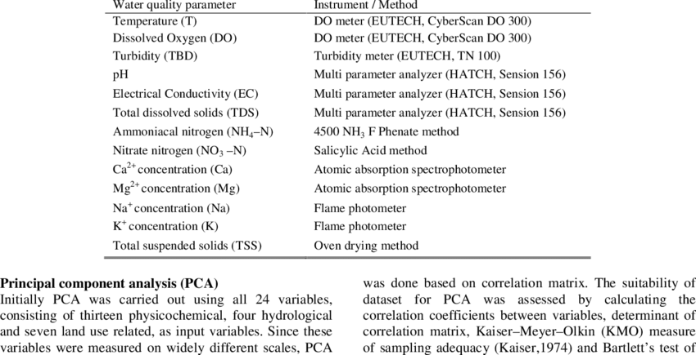
ANALYSIS OF WATER POLLUTION AND THEIR TESTING PROCEDURES

Slide 37
ANALYSIS OF WATER POLLUTION AND THEIR TESTING PROCEDURES
Physical factors: including suspended materials and dissolved substances.
Chemical factors: including concentrations of ions, pollutants, etc
Biological factors: including presence of organisms, plankton, macro invertebrates, fish, nutrients, etc

Slide 38
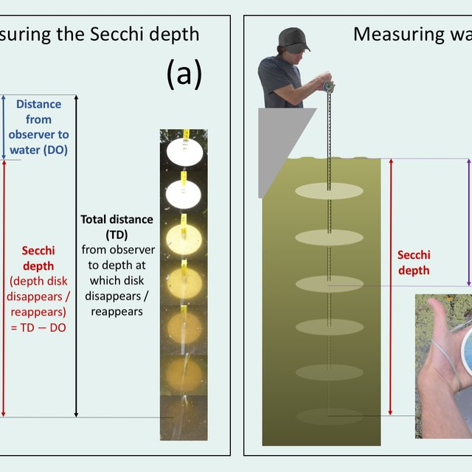
ANALYSIS OF WATER POLLUTION AND THEIR TESTING PROCEDURES
Turbidity: is a measure of the degree to which the water looses its transparency due to the presence of suspended particulates.
A Turbidity measurement could be used to provide an estimation of the TSS (Total Suspended Solids)
Turbidity is measured in NTU: Nephelometric Turbidity Units. Nephelometer, colorimeter or turbidimeter, which measures the intensity of light scattered at 90 degrees as a beam of light passes through a water sample.
In lakes or bays, turbidity is measured with a secchi disk.

Slide 39
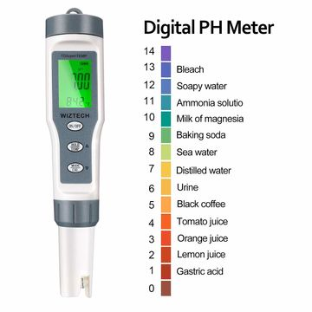
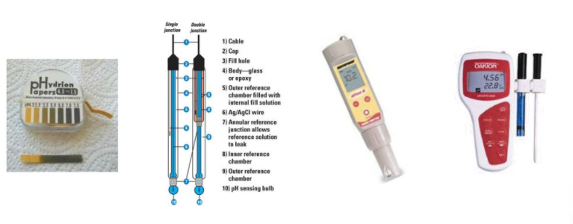
ANALYSIS OF WATER POLLUTION AND THEIR TESTING PROCEDURES
pH is a measure of the increase of Hydrogen ions in water
Additional carbon dioxide in freshwater can decreases the pH,.
It can measure by calibrated meter

Slide 40
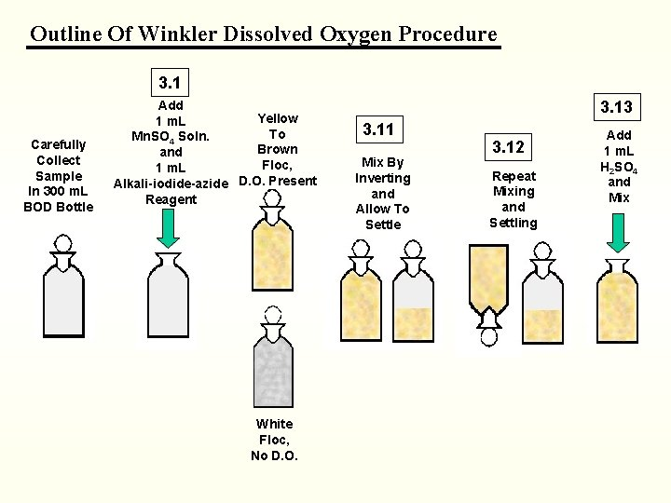
ANALYSIS OF WATER – DISSOLVED OXYGEN
Dissolved Oxygen is sometimes referred to as DO.
The titration method to measure DO is called the winkler titration

Slide 41
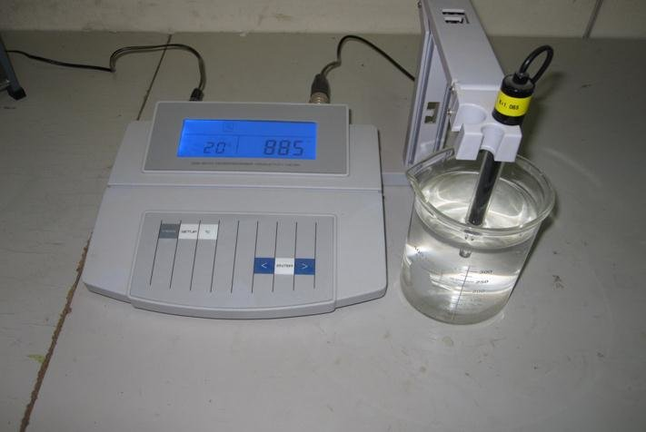
ANALYSIS OF WATER – Conductivity
Measuring the conductivity is an accurate way to determine salinity .
Conductivity of ions is measured using the following two units
Fresh water = Micro siemens
Saltwater = milli siemens

Slide 42
BACTERIOLOGICAL ANALYSIS
It is done primarily to determine its potability ie, fitness for drinking.
As many diseases of the intestinal origin eg. Typhoid fever, dysentery etc. have transmitted to humans via polluted water, this analysis indicates the degree of pollution, sewer as a useful measuring stick to determine the safety of water.
Tests for bacterial contamination:
E-Coli Test or B-Coli Test.

Slide 43
BACTERIOLOGICAL ANALYSIS
E-Coli Test
a) Presumptive Test
Definite positions of diluted samples inoculated with lactose broth as culture medium are placed in standard fermentation tubes.
Incubated for 24 – 28 hours at 37⁰C
If gas is seen, test is +ve, bacteria's present else –ve.
b) Confirmed Test
carried out to confirm the presence of B-Coli
Portion of lactose broth showing +ve presumptive test is carefully transferred to another fermentation tube containing brilliant green lactose bile as culture medium.
Inculation for 48 Hrs. @ 37⁰C
1 + gas seen → +ve result and presence of B-Coli

Slide 44
BACTERIOLOGICAL ANALYSIS
Coliform Index:
It is a measure of the concentration of coliform organisms in a water sample. It is the reciprocal of the smallest quantity of a sample (ml) which would give a positive E-Coli Test .
E-Coli < 3 & > 10

Slide 45
BACTERIOLOGICAL ANALYSIS
Most Probable Number (MPN)
It indicates the bacterial density which is most likely to be present in water. It is obtained by applying the laws of probabilities of statistics to the test results. Hence it is more accurate.
Membrane Filter Technique
Sample of water is filtered through a sterilized membrane containing unicroscopic pores to retain bacterias.
The membrane with the retained bacterias is incubated for 20 Hours at 37⁰C with nutrients
Membrane is taken out and colories of bacterias are counted by means of microscope.

Slide 46


Slide 47
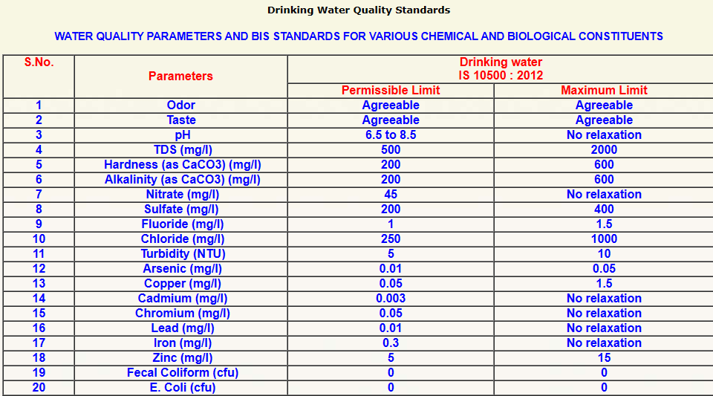

Slide 48
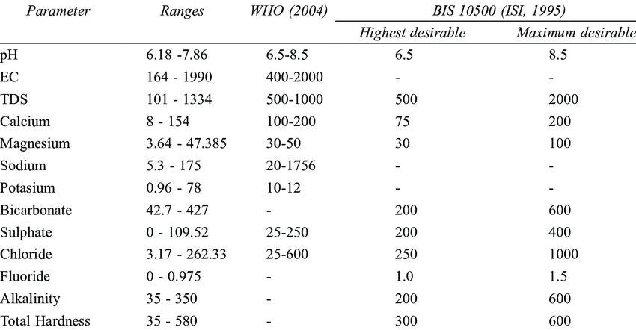
BIS – WATER QUALITY STANDARDS

Slide 49
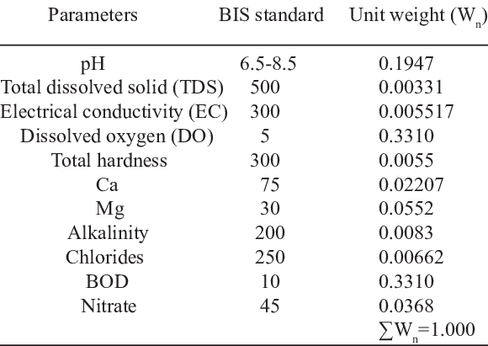
BIS – WATER QUALITY STANDARDS

Slide 50
BIS – WATER QUALITY STANDARDS
IS 10500:2012
Download it from this link
http://cgwb.gov.in/Documents/WQ-standards.pdf

Slide 51
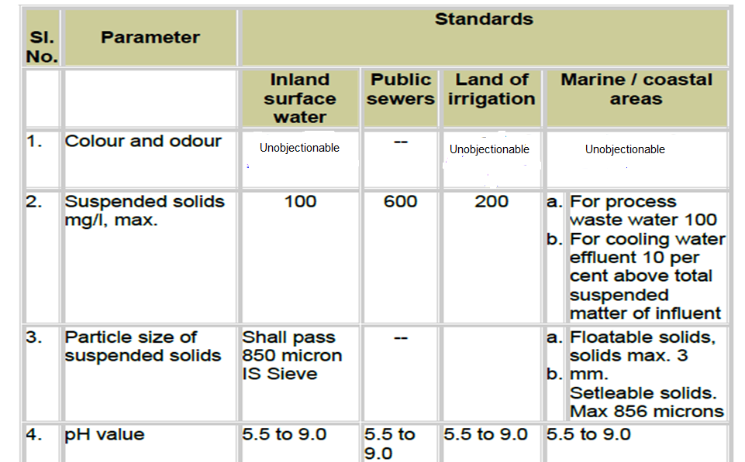
DISCHARGE OF EFFLUENT AND THEIR STANDARDS

Slide 52
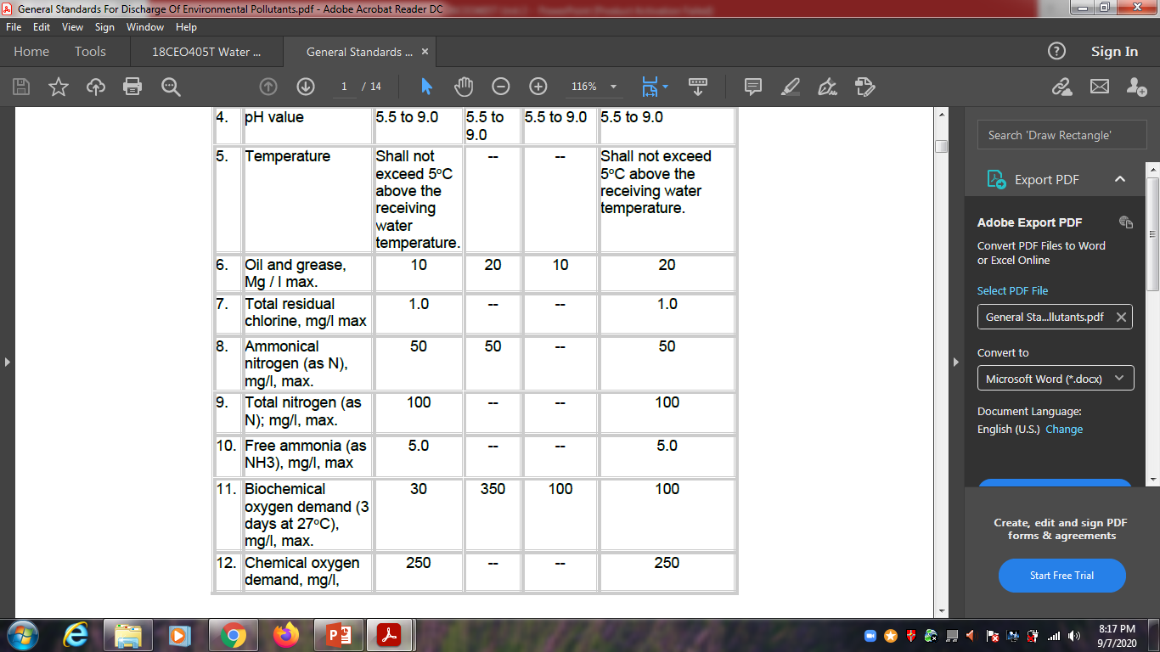
DISCHARGE OF EFFLUENT AND THEIR STANDARDS

Slide 53
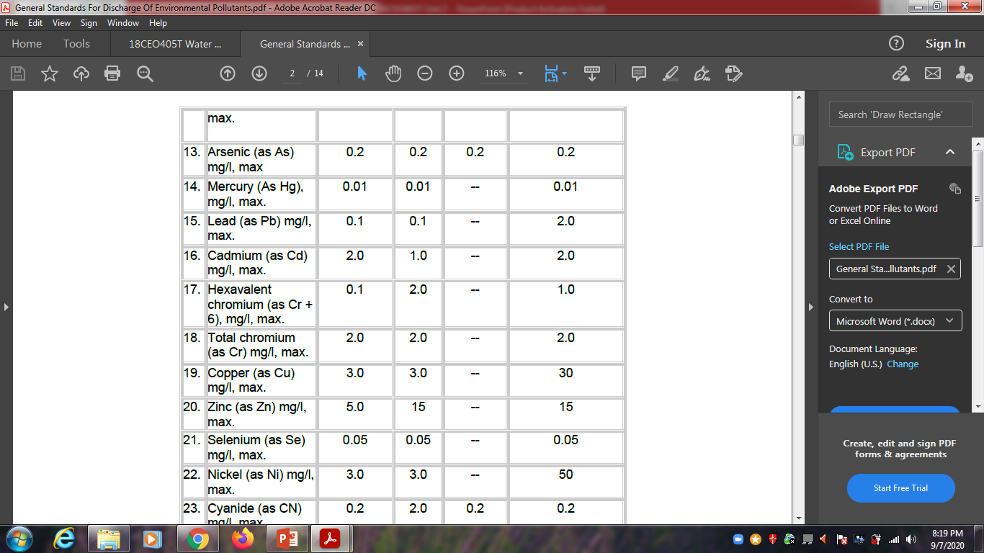
DISCHARGE OF EFFLUENT AND THEIR STANDARDS

Slide 54
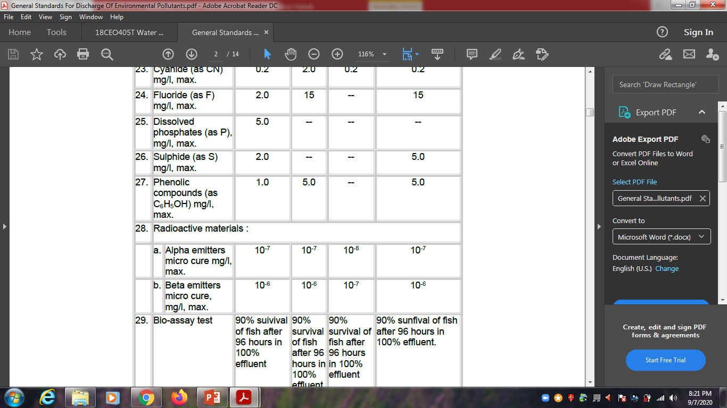
DISCHARGE OF EFFLUENT AND THEIR STANDARDS

Slide 55
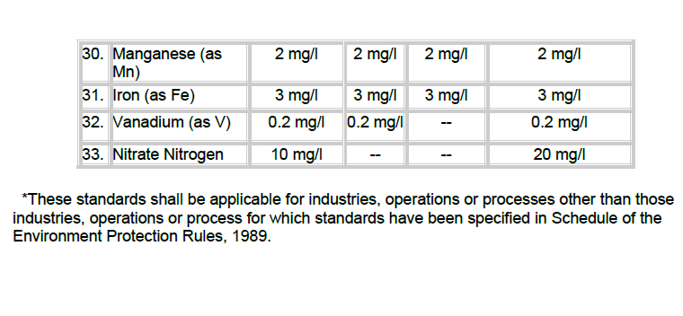
Refer: Effluent Standards.pdf
DISCHARGE OF EFFLUENT AND THEIR STANDARDS

Slide 56
S3-SLO2- Water quality standards and BIS.
IS 10500:2012
Download it from this link
http://cgwb.gov.in/Documents/WQ-standards.pdf

Slide 57
DISCHARGE OF EFFLUENT AND THEIR STANDARDS

Slide 58
DISCHARGE OF EFFLUENT AND THEIR STANDARDS

Slide 59
DISCHARGE OF EFFLUENT AND THEIR STANDARDS

Slide 60
DISCHARGE OF EFFLUENT AND THEIR STANDARDS

Slide 61
Refer: Effluent Standards.pdf
DISCHARGE OF EFFLUENT AND THEIR STANDARDS

Slide 62

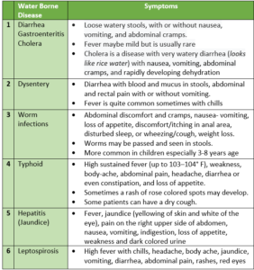
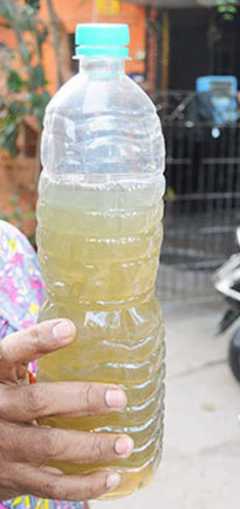
WATER BORNE DISEASES

Slide 63
WATER BORNE DISEASES
Water-Borne Diseases and their Impact
The pathogenic microorganisms, their toxic exudates, and other contaminants together, cause serious conditions such as cholera, diarrhea, typhoid, amebiasis, hepatitis, gastroenteritis, giardiasis, campylobacteriosis, scabies, and worm infections, to name a few.
Diarrhea
The most common of all water-borne diseases, diarrhea, mainly affects children below five years of age.
The symptoms include dizziness, dehydration, pale skin, and loss of consciousness in severe cases. It usually lasts for a couple of weeks and can turn out to be fatal if it goes untreated.

Slide 64
WATER BORNE DISEASES
Cholera
It is mainly caused by bacteria named Vibrio cholerae via consumption of contaminated food or drinking water.
The symptoms include diarrhea, vomiting, fever, and abdominal cramps. Cholera occurs predominantly in children, but can also affect adults.
It possesses a mortality rate that is alarmingly high among the water-borne diseases.
Typhoid
Typhoid fever is caused by Salmonella typhi bacteria transmitted via contaminated water. The patients typically suffer from prolonged episodes of fever, loss of appetite, nausea, headache, constipation, and loss of body weight.
Prompt attention is needed to cure typhoid in the patient, as well as to prevent the spread of this contagious disease.

Slide 65
WATER BORNE DISEASES
Amoebiasis
It is caused by a parasite named Entamoeba histolytica. The protozoan organism is transmitted by unknowingly consuming cysts (an inactive form of the parasite) in food, and it affects the intestine. The parasite thrives on contaminated soil and fecal matter. The common symptoms of amoebiasis include abdominal cramps and watery stools.
Hepatitis A
This condition mainly affects the liver and is caused by Hepatitis A virus. The route of contamination is usually oral, while it also spreads through physical contact with an infected person. Hepatitis A patients manifest common symptoms such as fever, nausea, and vomiting, but can suffer severe complications if they’re not treated in time.

Slide 66
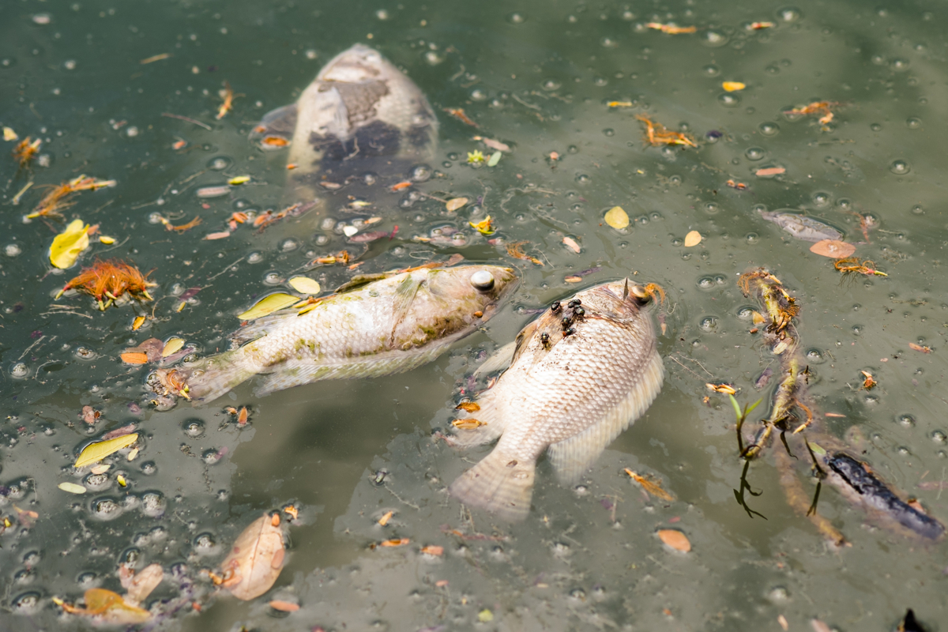
IMPACT OF WATER RELATED ISSUES ON ANIMALS

Slide 67
IMPACT OF WATER RELATED ISSUES ON ANIMALS
Proliferation of toxic algae species also impacts the health of both wildlife and humans.
When these algae flourish because of nutrient pollution in the water, they produce toxins that poison aquatic organisms, such as seabirds, fish, sea turtles and aquatic mammals, like dolphins, manatees and sea lions.
Plastics and other marine debris that can float may persist in the oceans for years, traveling the currents. Some of this material accumulates in the centers of ocean gyres, creating great garbage patches.
The term “garbage patch” brings to mind floating islands of trash, but little of the debris can be seen on the surface. Garbage patches, instead, are areas where concentrations of flotsam and jetsam, mostly small pieces of plastic, are particularly high. This litter can distribute toxic chemicals throughout the oceans, snag and tear corals, and harm animals if they ingest pieces of plastic or become entangled in the debris.

Slide 68
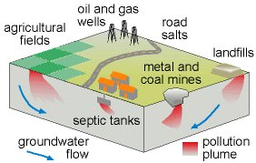
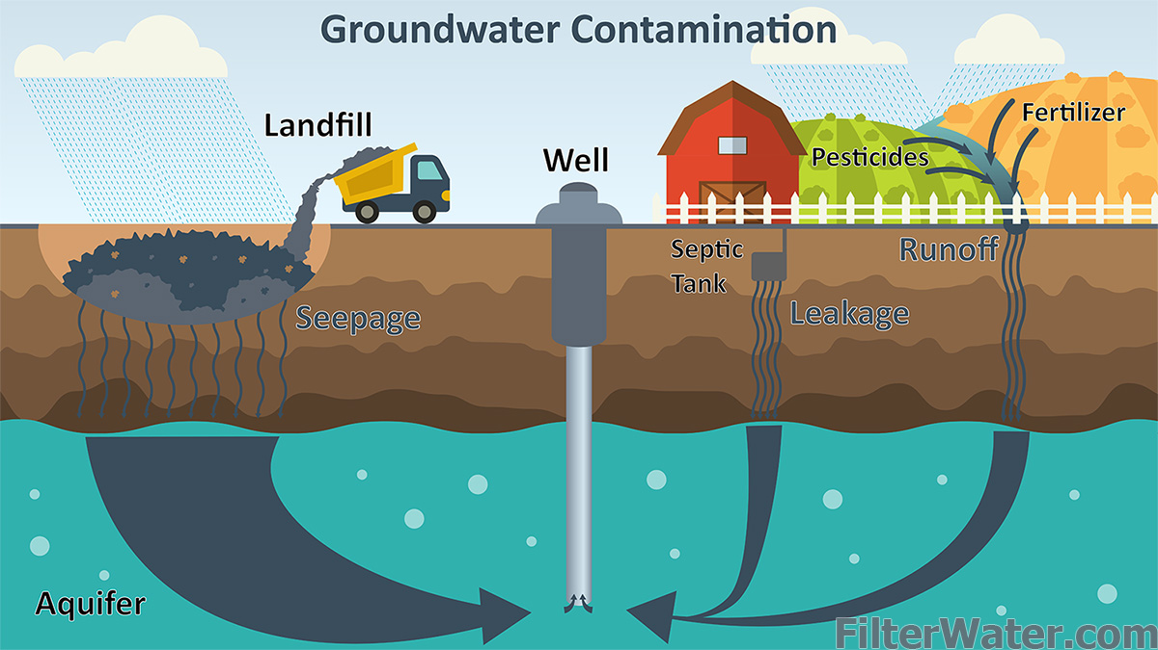
S5-SLO2- Ground water pollution

Slide 69
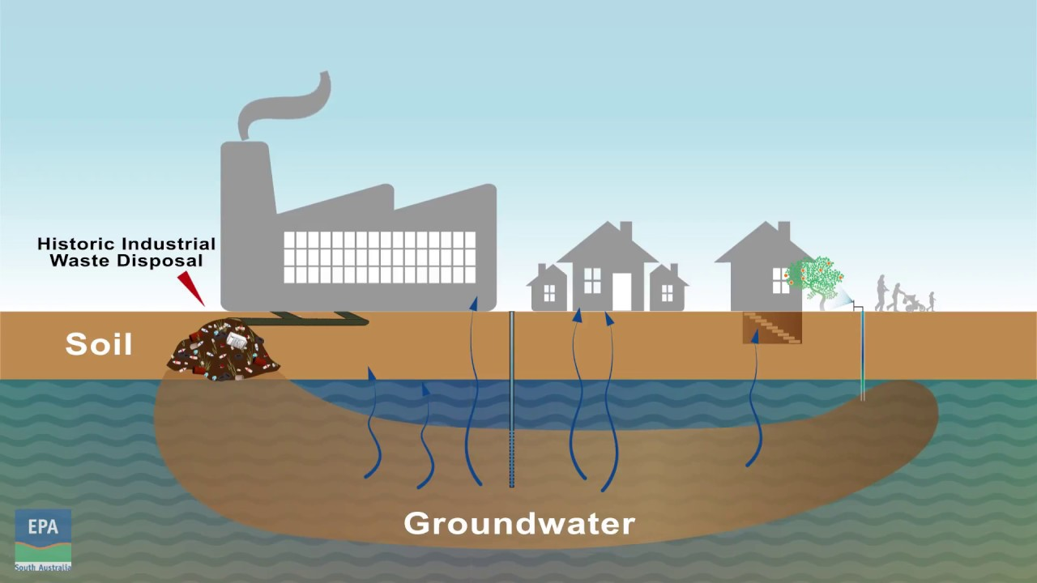
S5-SLO2- Ground water pollution
Image Source: Environment Protection Authority South Australia

Slide 70
GROUND WATER POLLUTION
Groundwater contamination occurs when man-made products such as gasoline, oil, road salts and chemicals get into the groundwater and cause it to become unsafe and unfit for human use.
Materials from the land's surface can move through the soil and end up in the groundwater. For example, pesticides and fertilizers can find their way into groundwater supplies over time. Road salt, toxic substances from mining sites, and used motor oil also may seep into groundwater. In addition, it is possible for untreated waste from septic tanks and toxic chemicals from underground storage tanks and leaky landfills to contaminate groundwater.
Ground water and surface water are interconnected and can be fully understood and intelligently managed only when that fact is acknowledged. If there is a water supply well near a source of contamination, that well runs the risk of becoming contaminated. If there is a nearby river or stream, that water body may also become polluted by the ground water.

Slide 71
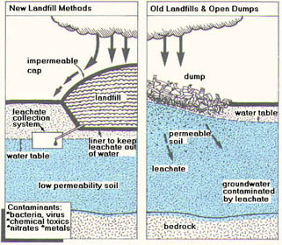
S5-SLO2- Ground water pollution

Slide 72
IMPACT ON EFFLUENT IN GROUND WATER QUALITY
Storage Tanks
May contain gasoline, oil, chemicals, or other types of liquids and they can either be above or below ground.
Over time the tanks can corrode, crack and develop leaks. If the contaminants leak out and get into the groundwater, serious contamination can occur.
Septic Systems
Onsite wastewater disposal systems used by homes, offices or other buildings that are not connected to a city sewer system.
Septic systems are designed to slowly drain away human waste at underground.
An improperly designed, located, constructed, or maintained septic system can leak bacteria, viruses, household chemicals, and other contaminants into the groundwater causing serious problems.

Slide 73
IMPACT ON EFFLUENT IN GROUND WATER QUALITY
Uncontrolled Hazardous Waste
Hazardous waste sites can lead to groundwater contamination if there are barrels or other containers laying around that are full of hazardous materials.
If there is a leak, these contaminants can eventually make their way down through the soil and into the groundwater.
Chemicals and Road Salts
The widespread use of chemicals and road salts is another source of potential groundwater contamination. Chemicals include products used on lawns and farm fields to kill weeds and insects and to fertilize plants, and other products used in homes and businesses.
When it rains, these chemicals can seep into the ground and eventually into the water.
Road salts are used in the wintertime to put melt ice on roads to keep cars from sliding around. When the ice melts, the salt gets washed off the roads and eventually ends up in the water.

Slide 74
EFFECTS OF GROUND WATER POLLUTION
Landfills
Landfills are the places that our garbage is taken to be buried. Landfills are supposed to have a protective bottom layer to prevent contaminants from getting into the water.
However, if there is no layer or it is cracked, contaminants from the landfill (car battery acid, paint, household cleaners, etc.) can make their way down into the groundwater.
Atmospheric Contaminants
Since groundwater is part of the hydrologic cycle, contaminants in other parts of the cycle, such as the atmosphere or bodies of surface water, can eventually be transferred into our groundwater supplies.

Slide 75
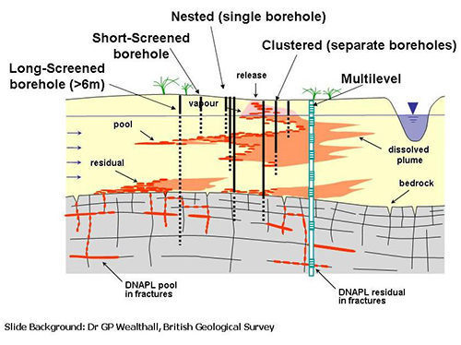
SAMPLING METHODS OF GROUND WATER POLLUTION

Slide 76
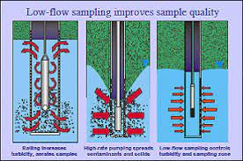
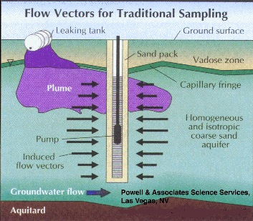
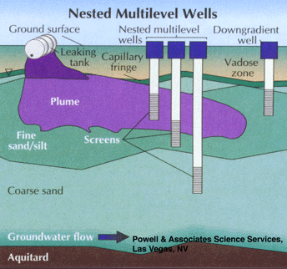
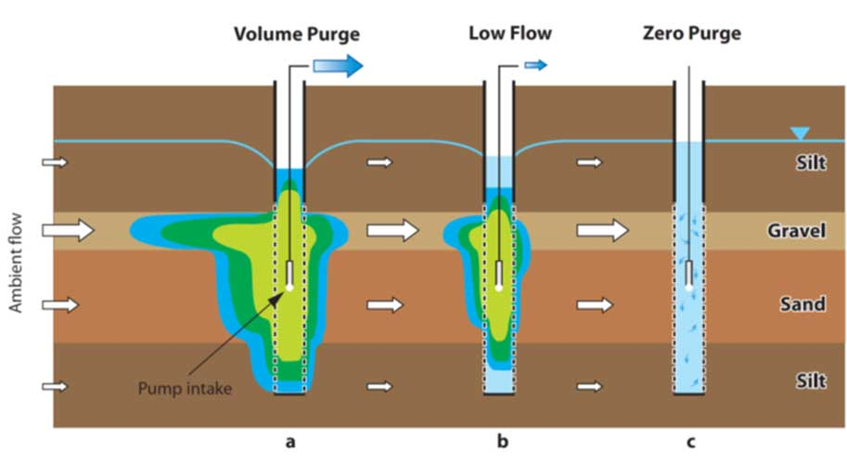
SAMPLING METHODS OF GROUND WATER POLLUTION

Slide 77
SAMPLING METHODS OF GROUND WATER POLLUTION
The collection of water samples from groundwater wells occurs in five steps:
Sampling preparations
Accessing the well before sampling and securing the well after sampling
Measuring the water level
Purging the well
Collecting and delivering the water sample
Sampling Preparations Before you take a water sample, the field sampling equipment should be cleaned and calibrated. Field sampling equipment includes
Pumping or bailing equipment
Water level meter
Water quality measuring equipment (These may include probes and instruments for measuring temperature, pH, electric conductivity, dissolved oxygen, reduction-oxidation potential, etc. Inexpensive meters or test kits are available from hardware and pet supply stores.)

Slide 78
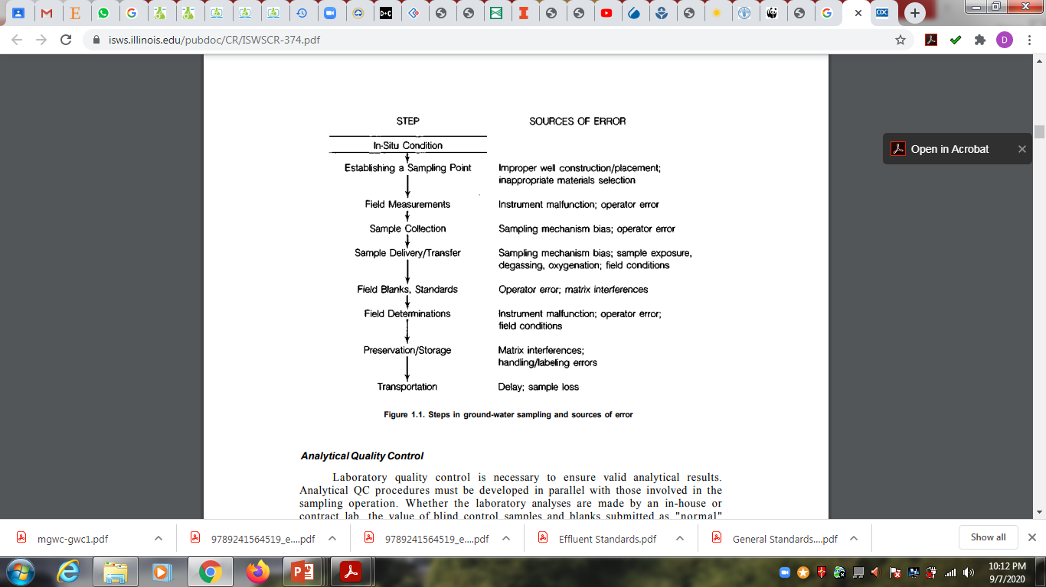
SAMPLING METHODS OF GROUND WATER POLLUTION

Slide 79
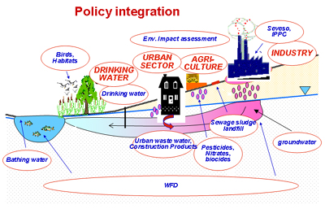
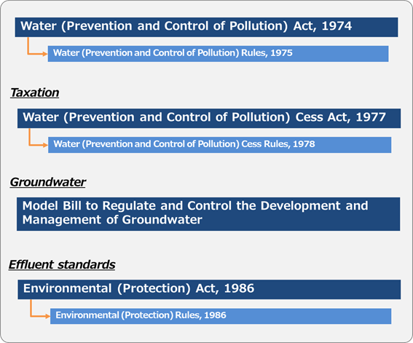
LEGAL REGULATORY ASPECTS OF GROUNDWATER CONTAMINATION

Slide 80
LEGAL REGULATORY ASPECTS OF GROUNDWATER CONTAMINATION
1986 -The Environment (Protection) Act authorizes the central government to protect and improve environmental quality, control and reduce pollution from all sources, and prohibit or restrict the setting and /or operation of any industrial facility on environmental grounds.
1986 -The Environment (Protection) Rules lay down procedures for setting standards of emission or discharge of environmental pollutants.
1989 -The objective of Hazardous Waste (Management and Handling) Rules is to control the generation, collection, treatment, import, storage, and handling of hazardous waste.

Slide 81
LEGAL REGULATORY ASPECTS OF GROUNDWATER CONTAMINATION
1989 -The Manufacture, Use, Import, Export, and Storage of hazardous Micro-organisms/ Genetically Engineered Organisms or Cells Rules were introduced with a view to protect the environment, nature, and health, in connection with the application of gene technology and microorganisms.
1991 -The Public Liability Insurance Act and Rules and Amendment, 1992 was drawn up to provide for public liability insurance for the purpose of providing immediate relief to the persons affected by accident while handling any hazardous substance.
1995 -The National Environmental Tribunal Act has been created to award compensation for damages to persons, property, and the environment arising from any activity involving hazardous substances.

Slide 82
INDUSTRIAL PARTICIPATION WITH REGULATORY BOARDS.
Industrial projects with investments above Rs 500 million must obtain MoEF clearance and are further required to obtain a LOI (Letter Of Intent) from the Ministry of Industry, and an NOC (No Objection Certificate) from the SPCB and the State Forest Department if the location involves forestland.
Once the NOC is obtained, the LOI is converted into an industrial licence by the state authority.
The Environmental Impact Assessment of Development Projects Notification, (1994 and as amended in 1997).

Slide 83
INDUSTRIAL PARTICIPATION WITH REGULATORY BOARDS.
A policy framework has also been developed to complement the legislative provisions. The Policy Statement for Abatement of Pollution and the National Conservation Strategy and Policy Statement on Environment and Development were brought out by the MoEF in 1992, to develop and promote initiatives for the protection and improvement of the environment.
The EAP (Environmental Action Programme) was formulated in 1993 with the objective of improving environmental services and integrating environmental considerations in to development programmes.

